Slide 1
Coffee Quality Analysis
Joseph Rios
Vignesh Sivanandha Rao

Slide 2

Overview
Background
Score Trends
Varieties
Processing Methods
Countries/Harvest Year
Producers
Altitude
Summary

Slide 3
Background
Coffee Quality Institute
Graded over 10 categories
Aroma
Flavor
Aftertaste
Acidity
Body
Balance
Uniformity
Clean Cup
Sweetness
“Cupper” Points
Other Information:
Species/Variety
Processing Method
Country of Origin
Harvest Year
Altitude

Slide 4
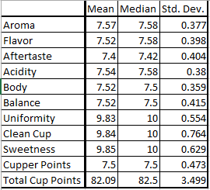
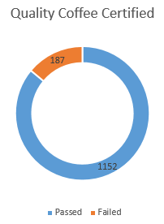
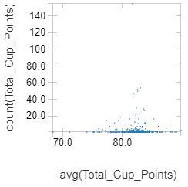
Baseline Score Statistics

Slide 5
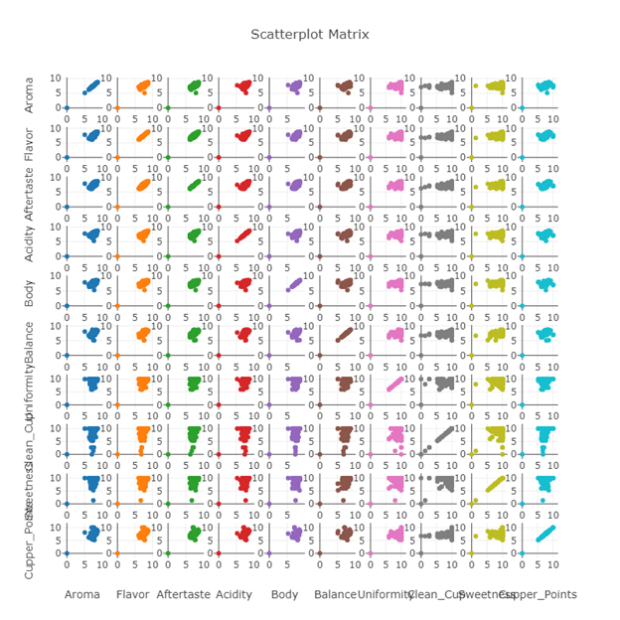

Slide 6
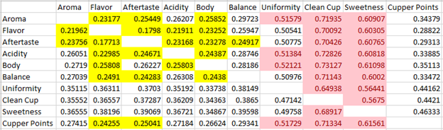
Correlations among Individual Scores

Slide 7
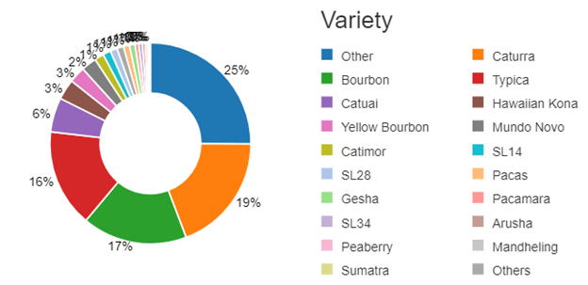
Varieties

Slide 8
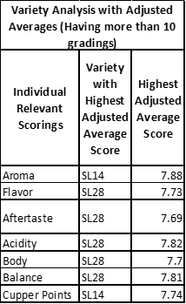
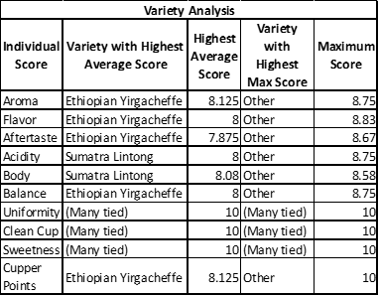
Varieties (cont.)

Slide 9
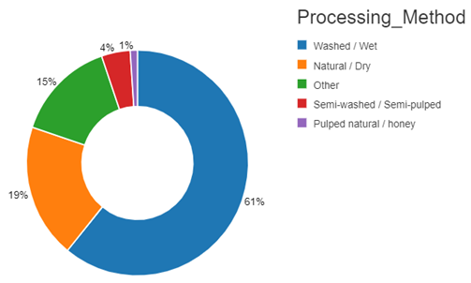
Processing Methods

Slide 10
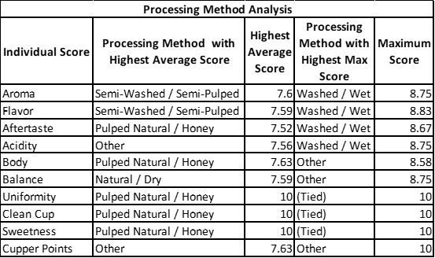
Processing Methods (cont.)

Slide 11
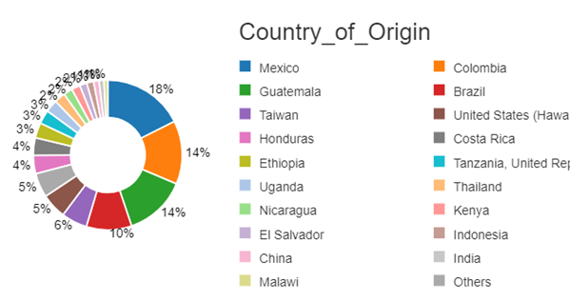
Countries/Harvest Year

Slide 12
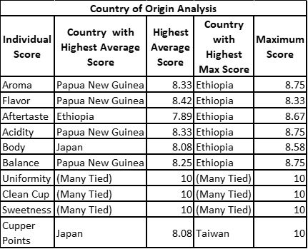
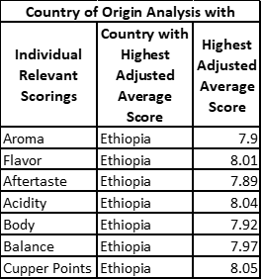
Countries/Harvest Year (cont.)

Slide 13
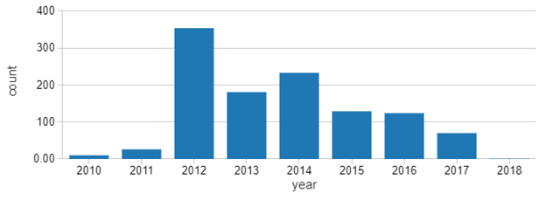
Countries/Harvest Year (cont.)

Slide 14
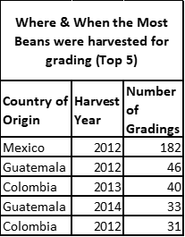
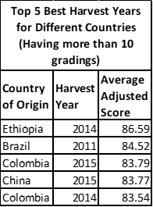
Countries/Harvest Year (cont.)

Slide 15
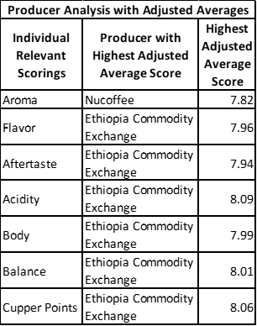
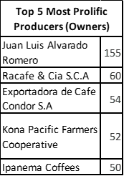
Producers

Slide 16
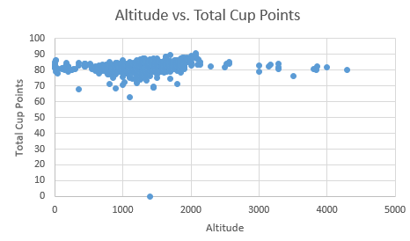
Altitude

Slide 17
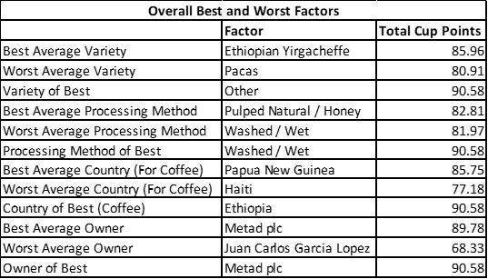
Summary

